Slide 1
Musical Cubes
“The Three Sided Die”
Eli Doggart, Owen Krause, Matthew Sweeney

Slide 2

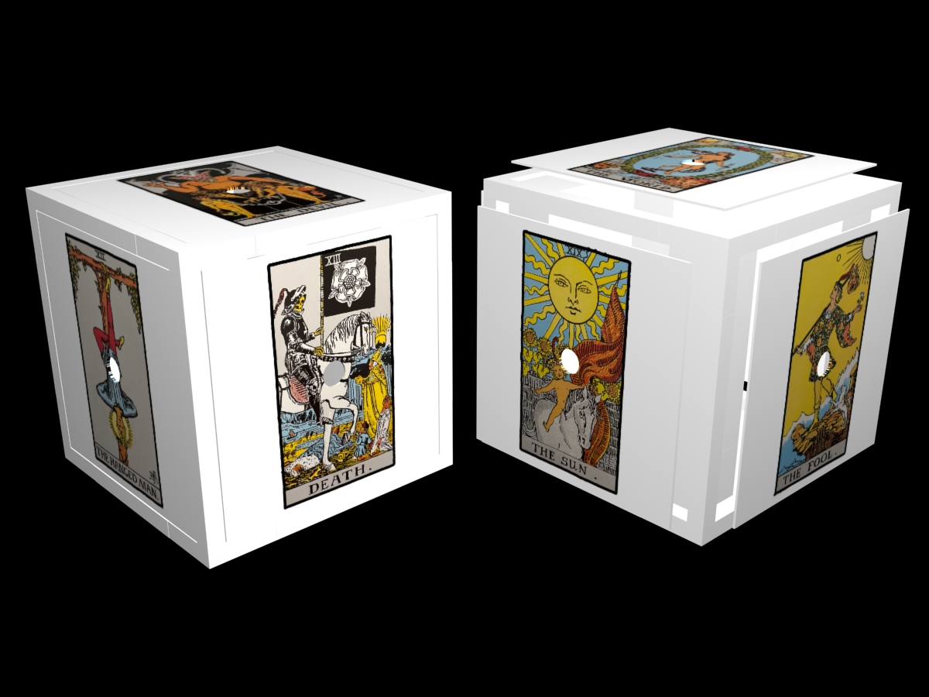
Goal
Design and fabricate a cube that connects to a computer and based on the side it lands on when rolled commands a musical result.

Slide 3
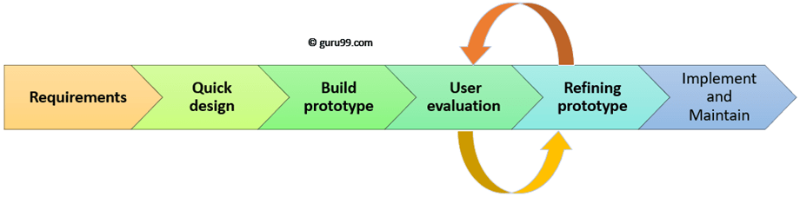
Term Plan
Develop and understanding of requirements
Select components and design cube around them
Fabricate cube
Evaluate cube
Prototype design
In programming phase

Slide 4
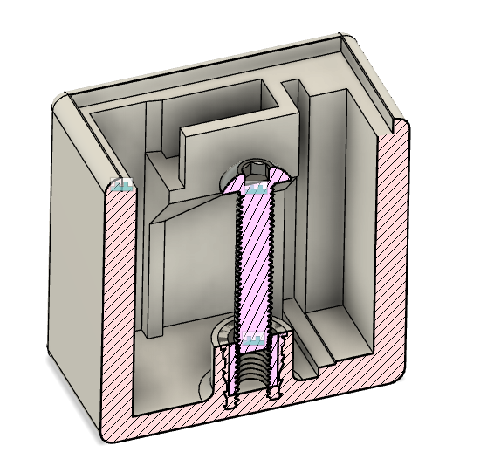
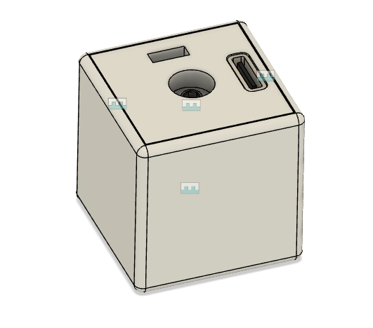
Accomplishments
Made a second cube
The board can now slide in and out of the cube for easy access
Decided that we will code to the cubes to be a midi device so that editing midi files will be easier.
Found multiple video describing how to set up an arduino device as a midi device

Slide 5
Challenges
Transmitting data over bluetooth from the cube
Setting up the microcontroller as a midi device
Figuring out how to take the acceleration data and make it control an aspect of a midi file.
Bluetooth low energy is extremely finicky, making testing fairly difficult

